Slide 1
LANDSLIDES MONITORING AND EARLY WARNING SYSTEM

Slide 2
Group identification
All four members are in Electronic and Telecommunication Engineering Field.
Members
W.M.S.Swarnapali 160472
A.S.Petersay 160346
L.P.Achinthya 160490
E.H.D.Y.L.Rathnasiri 160562

Slide 3
Project details
Name – Landslides Monitoring And Early
Warning System
Duration - 3 Months
Supervisor - Eng B.S.Samarasiri

Slide 4

Introduction
Sri Lanka is a country which is free from number of natural disasters such as volcanic eruptions, earthquakes, tsunamis, wildfire etc.

Slide 5
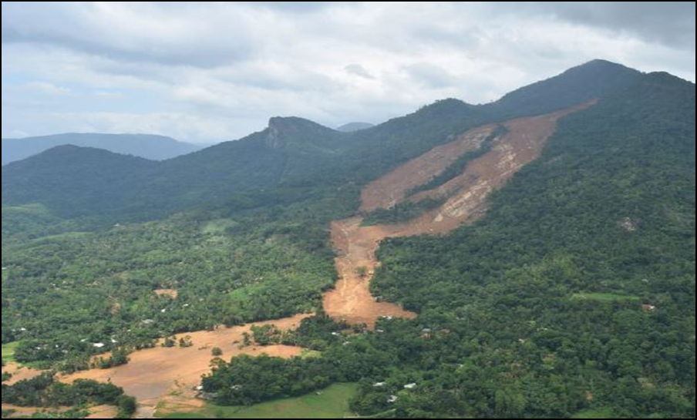
But, still, Sri Lanka faces natural disasters such as floods, landslides, cyclones, drought, lightning strikes etc.
Out of them, landslides has become a major and frequent disaster in the country and is the most pressing natural disaster in the central Highland.

Slide 6
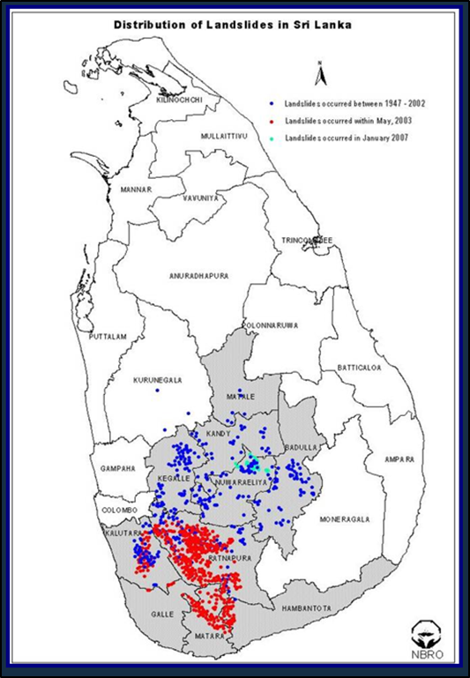
About 38% of population is affected by this hazard.
Around 20-30% of lands are identified as landslide prone areas which cover around 13 districts.
Landslides has become a major topic in the society due to the incidents such as landslide occurred at Aranayake and the landslide occurred in May, 2017.

Slide 7
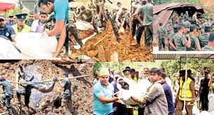
Damages due to landslides
Loss of lives
• Huge damage and destruction to properties
• Huge loss to people’s economy as well as country’s economy (this is because, apart from the damages to their properties (such as houses, shops) most of the time their cultivations also get fully destroyed)

Slide 8

National Building Research Organization (NBRO) is a leading research and development institution in the country and functions as the national focal point for landslide risk management and conducts landslide investigation and risk assessment
NBRO uses the above mentioned procedures to give the early warning for landslides.

Slide 9
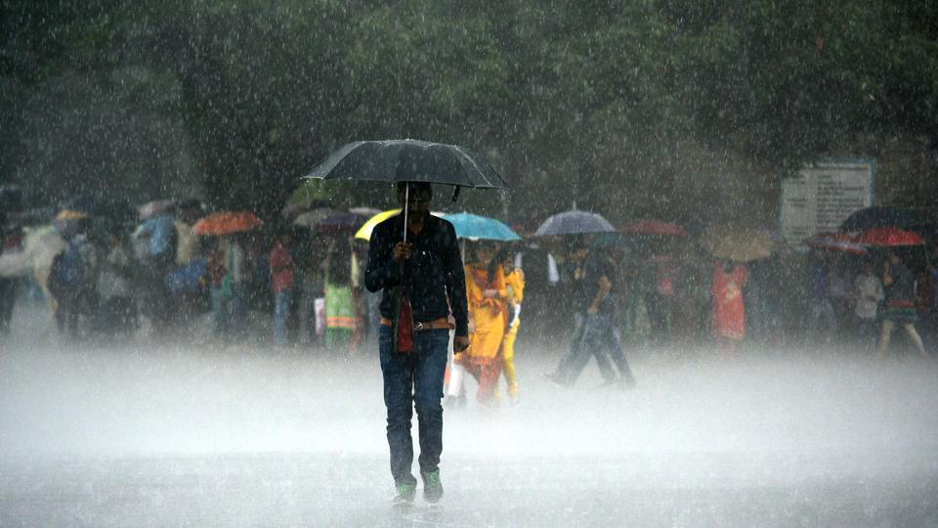
• NBRO has identified certain areas in the country, which are not suitable for living and they have taken steps to discourage the constructions in these areas
• NBRO has a rainfall monitoring system for the entire country and based on the rainfall in a prone area, if the rainfall of that area is above a pre-determined critical value, NBRO issues landslide early warnings for that area.

Slide 10

The above mentioned methods seem to be good methods, but sometimes they fail due to various reasons.
Among them, warning issuing time plays a vital role.

Slide 11
Considering this as an Engineering problem in our country, we decided to implement a
“Landslides Monitoring and Early Warning System”,
which is capable in identifying the changes in some selected factors which confirms the occurrence of a landslide beforehand and warns the people in the considered area

Slide 12
Importance of our design
First main important factor of our project is our design takes very short period of time to identify the landslide risk and it helps to take quick actions such as removing residence from risk areas
Second main important factor is that , this is a real time monitoring system for landslides hazard.

Slide 13

Objectives of our project
Introduce a cost effective system which can detect a possible landslides and send a message through a warning system connected to a web server and sending SMS for selected people in prone areas.
Design and implement a prototype for the system.

Slide 14
Reduce the death toll caused due to landslides, by issuing the warning at correct time for the people to evacuate from the area.
Create an environment where the people in prone areas, be able to live a life without uncertainty and fear.

Slide 15
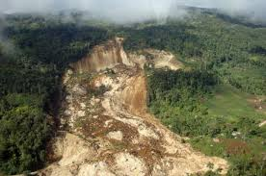
What is a landslide?
A landslide is defined as the movement of a mass of rocks, debris, or earth down a slope.
They are a type of “mass wasting”, which denotes any down-slope movement of soil and rock under the direct influence of gravity.

Slide 16
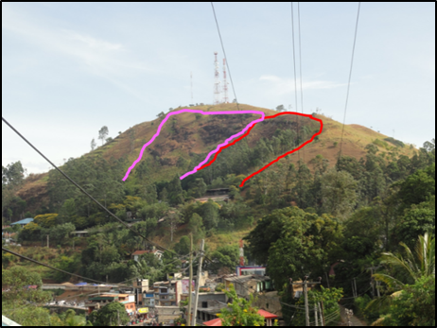
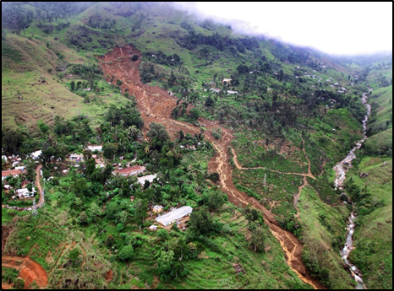
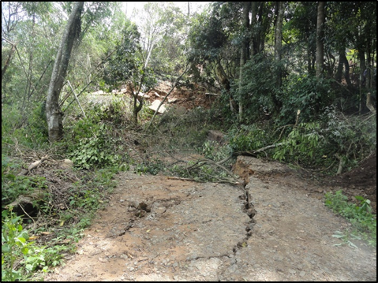
Landslides can be identified as….
• Landslides occurred in the past (Old Landslides)
• Landslides occurred recently (Recently Occurred Landslides)
• Landslides occur in future (Potential Landslides)

Slide 17
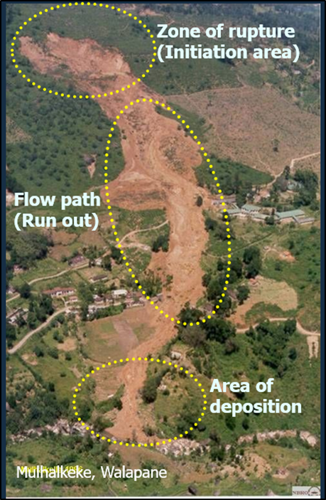
Damage zones of a landslide
The entire area that a landslide occurs has been divided into three zones. They are;
• Zone of rupture
• Flow path
• Area of deposition

Slide 18
Mechanism of landslides

Slide 19

Mechanism of landslides
The two main basic determinative parameters significant for landslides are ;
• Increase in shear stress (strain gauge)
• Decrease in material strength(soil moisture sensor)

Slide 20
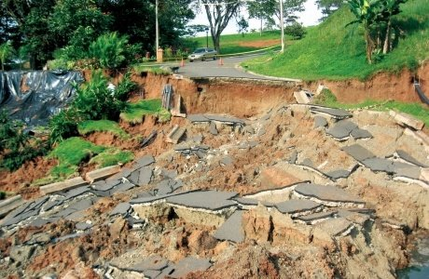
Mechanism of landslides contd.
The Increase of shear stress, which may be the cause of removal of lateral and underlying support.
A decrease of material strength, which may the cause of weathering, pore water pressure, solution activity and changes in material structure.

Slide 21
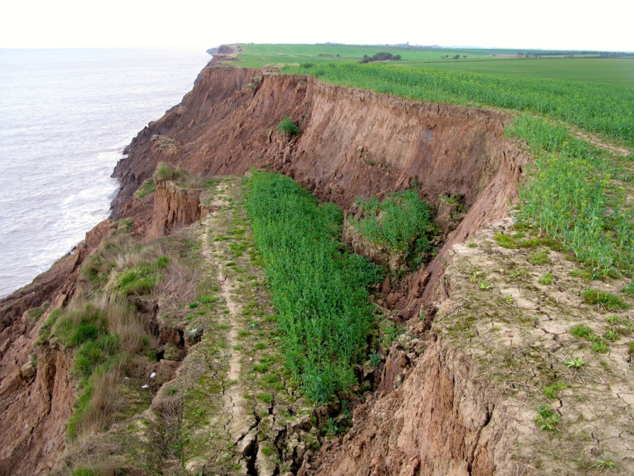
Mechanism of landslides contd.
Movement occurs when the shear stress exceeds the shear strength of the material and difference with soil erosion.

Slide 22
Key elements of stability of the soil
Material Strength
Hydraulic Pressure (Groundwater and/or Brine/ Seismic)
Gravity (Slope Angles)

Slide 23
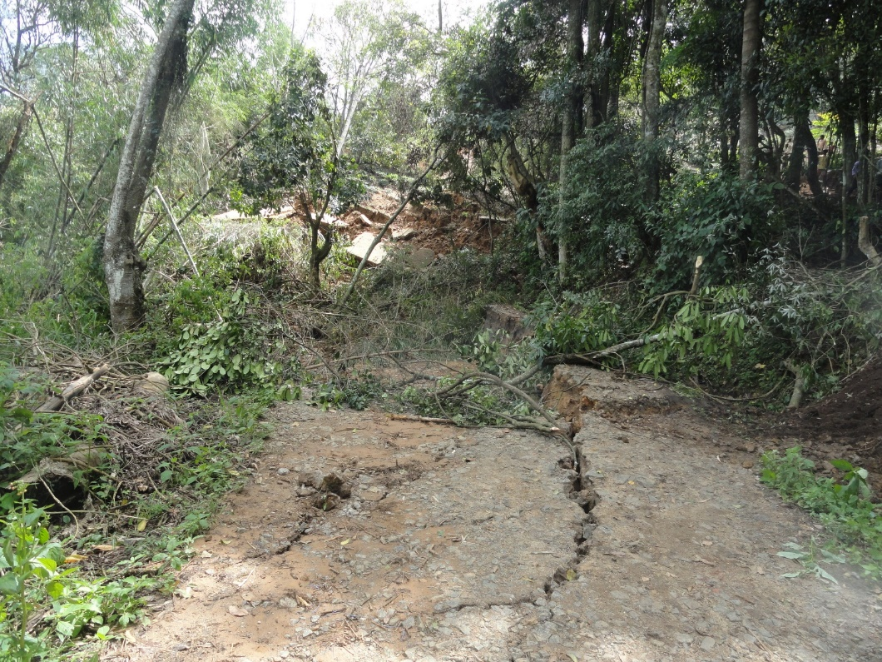
Key field observations of landslides
• Cracks
• Seepage on Dyke Slope
• Alignment Changes

Slide 24
Reasons for increasing trend of landslides
Community migration and settling in landslide prone areas (marginal lands).
Increasing the instability by haphazard constructions, land-use and management practices.
Change of rainfall pattern due to Climate change impact.

Slide 25
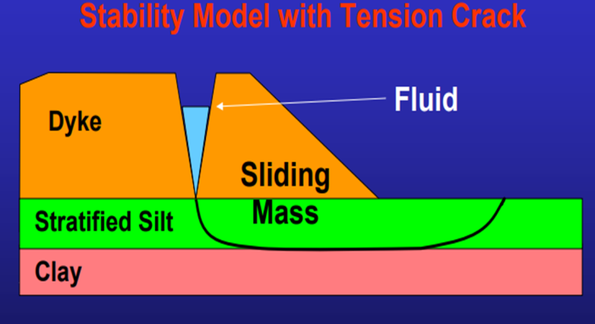
Identification of potential landslides
Tension cracks
“Tension cracks” indicate tension or pulling apart within the soil
The appearance of cracks at the soil surface usually precedes full failure and is a sure sign that movement is occurring within a slope

Slide 26
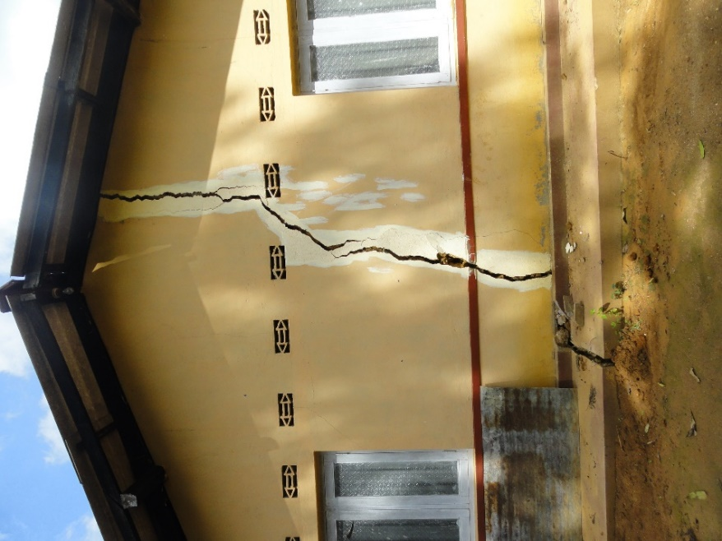
Identification of potential landslides contd.
• Leaning telephone poles, trees, retaining walls or fences.
• Broken water lines and other underground utilities.
• Offset fence lines.
• Tilting or cracking of concrete floors/walls and foundations.

Slide 27
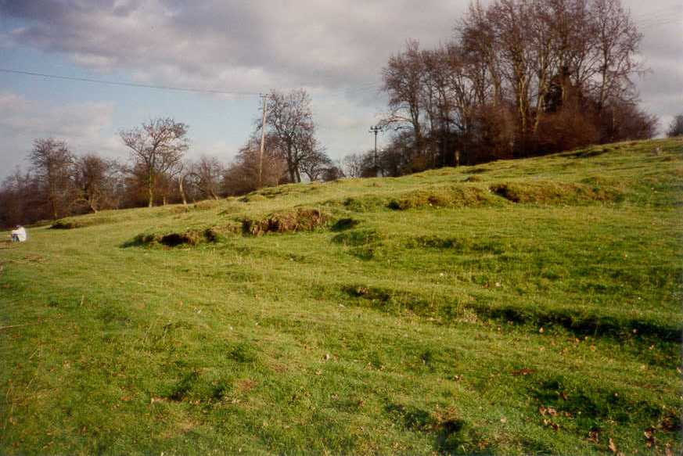
Identification of potential landslides contd.
• Soil moving away from foundations.
• Springs, seeps, or saturated ground in areas that have not typically been wet before.
• Sunken or down-dropped road beds.

Slide 28
Cost analysis of the system

Slide 29
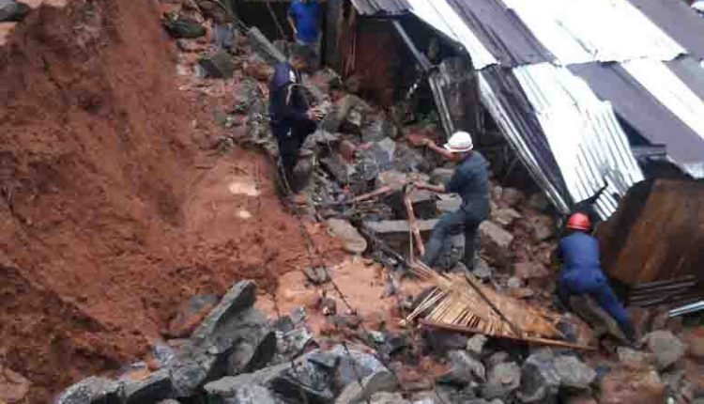
Effect of landslide hazard and early warning systems on economy
Warnings about dangers are of great benefit because the first warnings save lives and property.
There is no doubt that effective early warning systems have substantially reduced deaths and injuries caused by server weather events.

Slide 30
Why we need an early warning system for landslides?
Multiple rainfall failures and landslides have destroyed important parts of the population.
In many regions of the world, landslides cause billions of dollars in damages and often imply significant mortality rates.

Slide 31
Rapid warning systems are therefore important to reduce landslide hazards and, in particular, avoid causality and minimize evacuation costs.

Slide 32

Landslides impact on economic conditions in sri lanka
Despite the fact that all countries suffer from disasters, they have the greatest impact on developing and less developed nations, such as Sri Lanka.
Evidently, natural disasters between the years 1900-2015, based on over 30,000 events globally, resulted in an economic loss of $7 trillion.

Slide 33
Landslides impact on economic conditions in sri lanka contd.
The worst destruction since the floods and landslides in 2003 was the destruction of 264 houses and 10,000 houses. Most of the victims are tea and rubber plantation workers, farmers and small growers
They live up to poverty level of $ 1 to $ 2. Many are now helpless.

Slide 34
Landslides impact on economic conditions in sri lanka contd.
The cost of Sri Lanka’s landslides and floods will be between $1.5 billion and $2 billion at the minimum, the government said, as the Indian Ocean Island struggles to recover from its worst natural disaster

Slide 35
Landslides impact on economic conditions in sri lanka contd.
While the cost of expenses incurred by the local government due to the recent floods has yet to be determined, the Ministry of Disaster Management estimates that the total cost of the damage and losses during the floods of last year are Rs. 690 million.

Slide 36

Effect of landslides on the environment
Landslides affect the following elements of the environment
• The topography of the earth’s surface
• The character and quality of rivers and streams and groundwater flow
• The forests that cover much of the earth’s surface
• The habitats of natural wildlife that exist on the earth’s surface, including its rivers, lake and oceans.

Slide 37
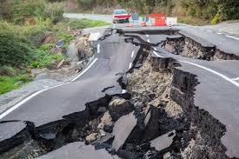
Natural causes of landslides
Earthquakes: Seismic activities have always been a main cause of landslides throughout the world. Any time plate tectonics move the soil that covers them moves with it. When earthquakes occur on areas with steep slopes, many times the soil slips causing landslides. Furthermore, ashen debris flows caused by earthquakes can also trigger mass movement of soil.

Slide 38
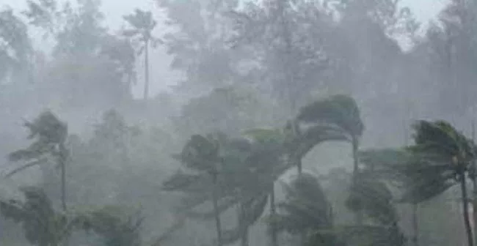
Natural causes of landslides contd.
Heavy Rainfall: When sloped areas become completely saturated by heavy rainfall many times landslides can occur. Without the aid of mechanical root support the soil simply runs off when it contains too much water.

Slide 39
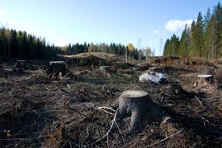
Human causes of landslides
Clear Cutting: Method of timber harvesting which completely removes all old growth timber from the area. This method is hazardous because it destroys the existing mechanical root structure in the area.
Mining: Mining operations that use blasting techniques often cause other areas that are at the risk of sliding to slide due to vibrations under the soil.

Slide 40
Working procedure of the proposed system

Slide 41
Working procedure of the proposed system contd.
The following factors were chosen for the automation of the system,
• Soil moisture content
• Sudden change in the strain of the soil

Slide 42
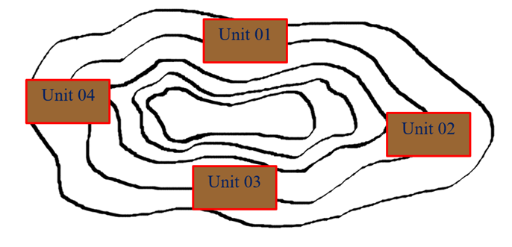
Working procedure of the proposed system contd.
we are planning to install four soil moisture sensors in four selected points around the mountain and also we are planning to fix strain gauges such that each one is located in between a crack

Slide 43
(Animation)

Slide 44
System design

Slide 45
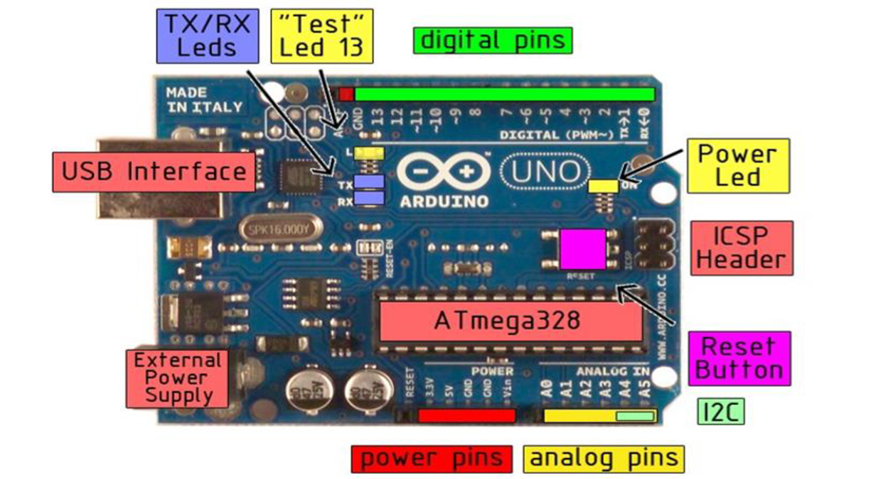
Hardware implementation
Arduino Uno board
Parts of the Arduino Uno Board

Slide 46
Technical specification
Microcontroller | ATmega328P – 8 bit AVR family microcontroller
Operating Voltage | 5V
Recommended input voltage | 7-12V
Input Voltage Limits | 6-20V
Analog Input Pins | 6 (A0 – A5)
Digital I/O Pins | 14 (Out of which 6 provide PWM output
DC Current on I/O Pins | 40 mA
DC Current on 3.3V Pin | 50 mA

Slide 47
Technical specification contd.
Flash Memory | 32 KB (0.5 KB is used for Bootloader)
SRAM | 2 KB
EEPROM | 1 KB
Frequency (Clock Speed) | 16 MHz

Slide 48
Pin description
Pin Category | Pin Name | Details
Power | Vin, 3.3V, 5V, GND | Vin: Input voltage to Arduino when using an external power source. 5V: Regulated power supply used to power microcontroller and other components on the board. 3.3V: 3.3V supply generated by on-board voltage regulator. Maximum current draw is 50mA. GND: ground pins.
Reset | Reset | Resets the microcontroller

Slide 49
Pin description contd.
Pin Category | Pin Name | Details
Analog Pins | A0 – A5 | Used to provide analog input in the range of 0-5V
Input/Output Pins | Digital Pins 0 - 13 | Can be used as input or output pins
Serial | 0(Rx), 1(Tx) | Used to receive and transmit TTL serial data
External Interrupts | 2, 3 | To trigger an interrupt

Slide 50
Pin description contd.
Pin Category | Pin Name | Details
PWM | 3, 5, 6, 9, 11 | Provides 8-bit PWM output.
SPI | 10 (SS), 11 (MOSI), 12 (MISO) and 13 (SCK) | Used for SPI communication
Inbuilt LED | 13 | To turn on the inbuilt LED.
TWI | A4 (SDA), A5 (SCA) | Used for TWI communication
AREF | AREF | To provide reference voltage for input voltage

Slide 51
Power | The Arduino Uno can be powered via the USB connection or with an external power supply
Memory | The Atmega328 has 32 KB of flash memory for storing code. It has also 2 KB of SRAM and 1 KB of EEPROM .
USB overcurrent protection | The Arduino Uno has a resettable poly fuse that protects your computer's USB ports from shorts and overcurrent. Computers provide their own internal protection, the fuse provides an extra layer of protection. If more than 500 mA is applied to the USB port, the fuse will automatically break the connection until the short or overload is removed.
Physical properties | The maximum length and width of the Uno PCB are 2.7 and 2.1 inches respectively, with the USB connector and power jack extending beyond the former dimension. Three screw holes allow the board to be attached to a surface or case.

Slide 52
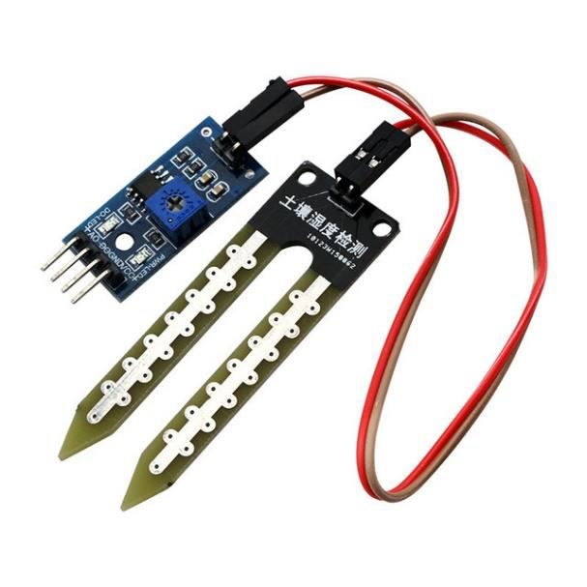
Soil moisture sensor
Soil moisture sensor consists
of a triple output mode, digital output is simple, analog output more accurate, serial output with exact readings
Soil moisture sensor consists
of two probes which are used to measure the volumetric content of water. The two probes allow the current to pass through the soil and then it gets the resistance value to measure the moisture value.

Slide 53
Specifications of the soil moisture sensor FC-28
Input Voltage | 3.3 – 5V
Output Voltage | 0 – 4.2V
Input Current | 35mA
Output Signal | Both Analog and Digital

Slide 54
Pin configuration
Vcc | For power
A0 | Analog output
D0 | Digital output
GND | Ground

Slide 55
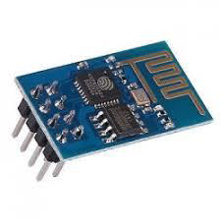
Wi-Fi module ESP 8266 ESP 01
The ESP8266 ESP-01 is a Wi-Fi module that allows microcontrollers access to a Wi-Fi network.
This module is a self-contained SOC (System On a Chip) that doesn’t necessarily need a microcontroller to manipulate inputs and outputs as you would normally do with an Arduino.

Slide 56
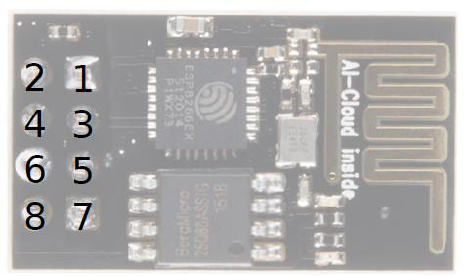
Pin description
No | Pin name
1 | GND
2 | TX0
3 | GPIO2
4 | CH_PD
5 | GPIO0
6 | RST
7 | RXI
8 | 3V

Slide 57
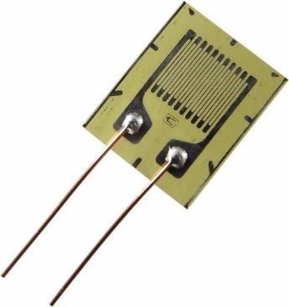
Strain gauge
Strain gauge is used to measure the strain of the materials which occurs due to tension or compression.

Slide 58

Installation of strain gauge in mountain

Slide 59
For this project we plan to place strain gauges on a pre-stressed rectangular metal plate.
Two cables are attached to the two ends of the metal plate.
Other ends of cables need to be connected to steel rods which will be eventually fixed firmly to the ground.
When considered a landslide situation a downhill rod (B) is more likely to move compared to uphill rod (A).
This will result in an alternation of the previous strain value (pre-stressed )
Prolonged gradual increment in the strain value can be used to detect a possible landslide.

Slide 60
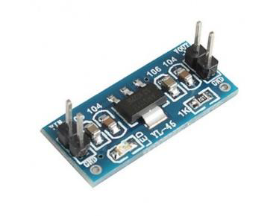
Voltage regulator – AMS1117
The AMS1117 series of adjustable and fixed voltage regulators are designed to provide up to 1A output current and to operate down to 1V input-to-output differential.

Slide 61
Pin connections
3 pin fixed/adjustable version
• Ground/Adjust
• VOUT
• VIN

Slide 62
Applications
• High Efficiency Linear Regulators 1.5V, 1.8V, 2.5V, 2.85V, 3.3V and 5.0V
• 5V to 3.3V Linear Regulator
• Battery Chargers
• Active SCSI Terminators

Slide 63
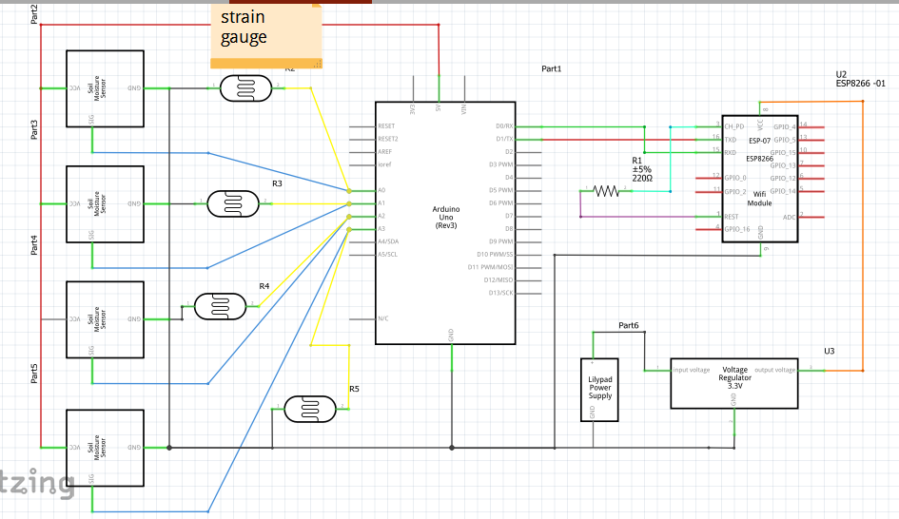
Processor unit

Slide 64
Block diagram
Power Supply
ESP8266 ESP01
Wi-Fi Module
Web Server
Soil Moisture Sensor
Arduino UNO
Text
Real Time Monitoring
Strain Gauge

Slide 65

Arduino IDE environment
The Arduino Software (IDE) contains a text editor for writing code, a message area, a text console, a toolbar with buttons for common functions and a series of menus.
Arduino IDE can be run on Windows or Linux on either 32 bit or 64 bit Application Size.
We used Arduino 1.8.5 Software to build our software. Basically this software enables better and assisted code editing, compiling and debugging.

Slide 66

Programming languages
In arduino, C programming language is used for programming.
It has been said that a program written in C will pay a premium of a 50 to 100% increase in running time, because no language is as compact or fast as Assembly language

Slide 67
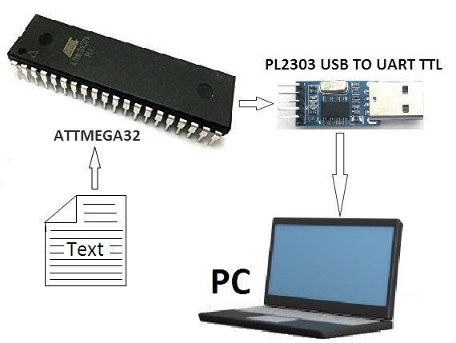
How arduino board communicating with personal computer
The arduino uno has a number of facilities for communicating with a computer, another arduino or other microcontrollers. The atmega328 provides UART TTL (5V) serial communication, which is available on digital pins 0 (RX) and 1 (TX).

Slide 68
The RX and TX leds on the board will flash when data is being transmitted via the usb-to-serial chip and USB connection to the computer

Slide 69
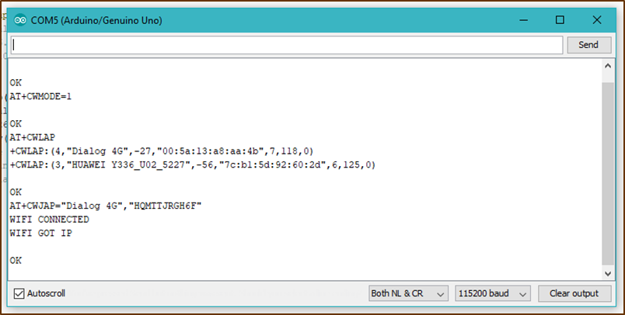
How arduino board communicating with ESP 8266 WIFI module
After connecting the Wi-Fi module (ESP 8266 – ESP 01), first we upload an empty program to the arduino in order to connect the Wi-Fi module to the available network. Following steps are followed in connecting the Wi-Fi module to the network.

Slide 70
AT
AT+CWLAP
AT+CWJAP=“ssid”,”password” After connecting to the network, then we upload the arduino code which deals with the soil moisture sensors, strain gauges and the thingspeak online web server.

Slide 71
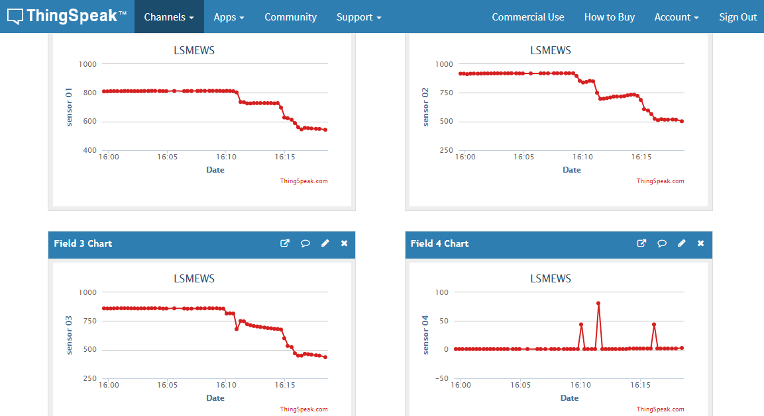
Thingspeak online web monitoring
Thingspeak enables sensors, instruments and websites to send data to the cloud where it is stored in either a private or a public channel.
It gets data in three ways. Such as
JSON(human readable text)
XML (encoding document in a format that is both human readable and machine readable)
CSV(simple file format such as a spread sheet or database)
Values in the XML file can also be used for online monitoring purpose. Once data is in a ThingSpeak channel, you can analyze and visualize it, calculate new data, or interact with other devices.

Slide 72
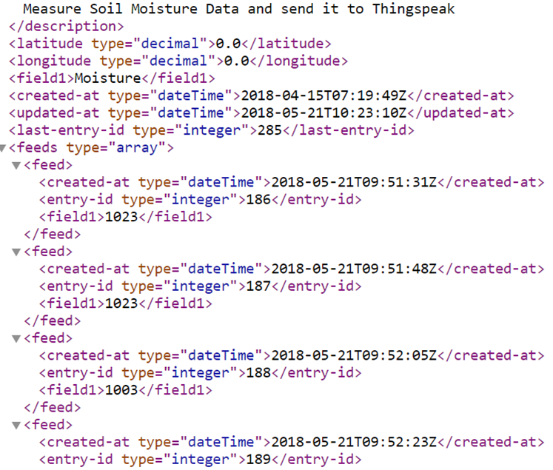
How monitoring was done with soil moisture sensor
Soil moisture sensor detects the amount of moisture in the soil repeatedly and the readings of each and every sensor fixed in different areas of the mountain, are plotted in the fields in the thingspeak web server. At the same time, these data will be recorded in a XML file in thingspeak.

Slide 73
Testing of sensors
In this project we wanted to find out a mathematical relationship between soil moisture variations with the addition of unit amount of water. Since the data we needed was not available in NBRO, We had to carry out certain experiments. Following graph was obtained by those data, and we have used this graph to find a critical value where the soil moisture sensors indicate the possibility of a landslide.

Slide 74
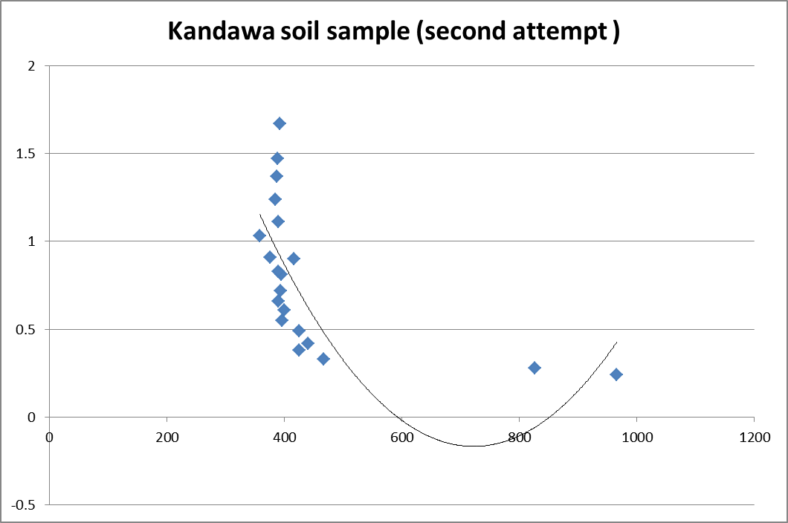

Slide 75
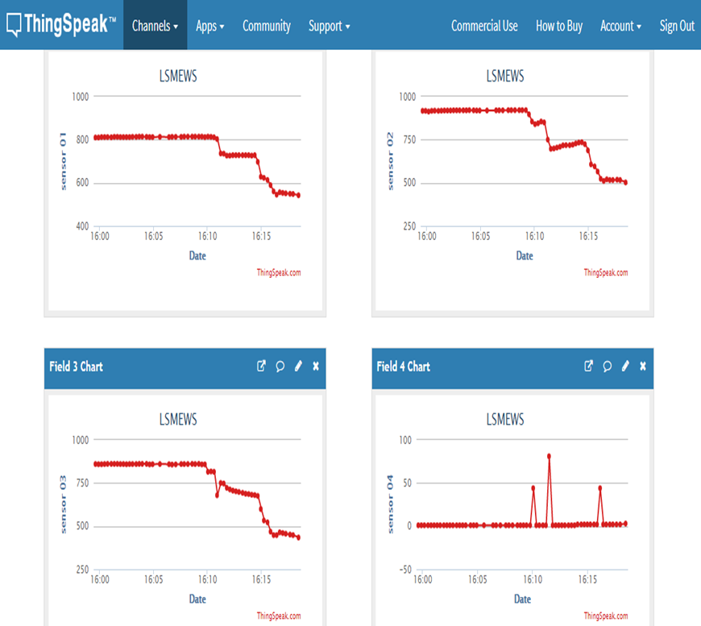
we’ve used this critical value (analog reading 500) to give the early warning, the SMS alert.

Slide 76
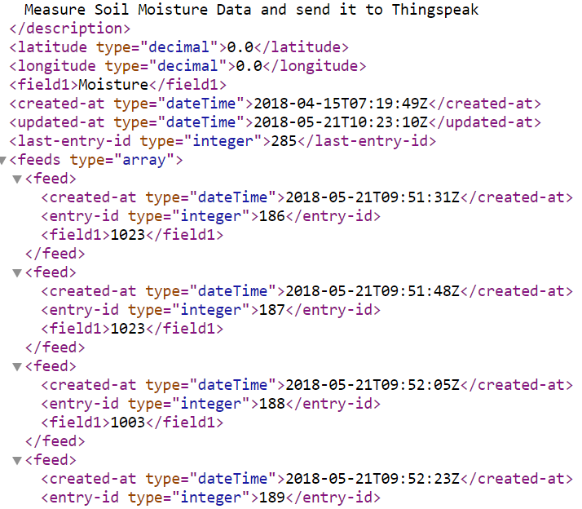
SMS alerts
Here, what happens is, the graphs of the sensors in thingspeak are monitored via a code and using the sensor readings in XML file the following is calculated.
Moisture value in xml

Slide 77
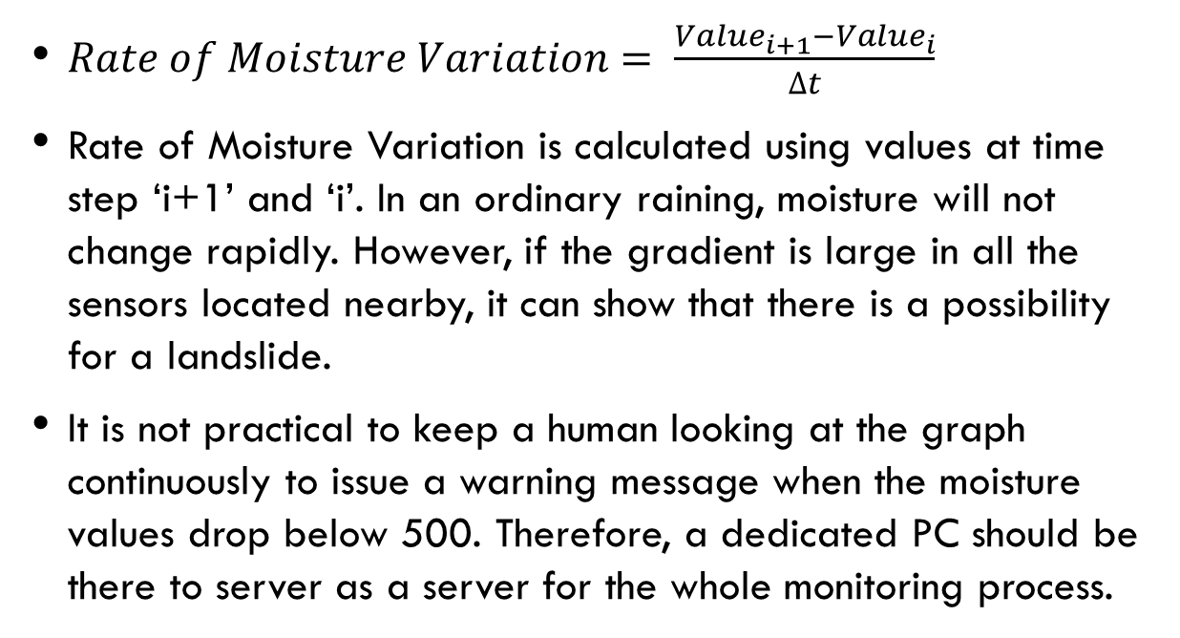
$Rate of Moisture Variation= \frac{{Value}_{i+1}−{Value}_{i}}{∆t}$
Rate of Moisture Variation is calculated using values at time step ‘i+1’ and ‘i’. In an ordinary raining, moisture will not change rapidly. However, if the gradient is large in all the sensors located nearby, it can show that there is a possibility for a landslide.
It is not practical to keep a human looking at the graph continuously to issue a warning message when the moisture values drop below 500. Therefore, a dedicated PC should be there to server as a server for the whole monitoring process.

Slide 78

In this project a python program is used to check the values in the xml file. Python program checks the xml value every few minutes and checks whether the values have reached to a critical level.
A python or another program should run in the monitoring computer to detect sudden changes in the moisture values.
If there is a possibility for a landslide this program should trigger a warning message which should be sent to a bulk messaging portal eventually (e.g. Through Dialog, Mobitel or any service provider)

Slide 79
Cost analysis for the system
CATEGORY | QUANTITY | REFERENCE | UNIT COST (Rs.) | COST(Rs.)
Arduino Uno | 1 | LTARDC01 | 925 | 925
soil moisture sensor | 4 | LTMODSENOTH17 | 110 | 440
strain gauge | 4 | LTMODSENOTH | 170 | 680
voltage regulator | 1 | LTPS04 | 80 | 80
ESP 8266 Wi-Fi module | 1 | LTWIFI10 | 425 | 425
power supply | 1 |  | 650 | 650
PCB design |  |  |  | 600
TOTAL COST |  |  |  | 3800

Slide 80

So from the total cost analysis of our final product, it is clear that we have to spend Rs.3800/- for the system. But when we consider the above given details, and compare the amount of money that the government has to spend when a landslide disaster occurs and the amount of money that has to be spent on this system, the cost for this system is a fair value. So our final product is a cost effective one.

Slide 81
Discussion
In this project our aim was to implement a “Landslides Monitoring and Early Warning System”, which is capable in identifying the changes in some selected factors (selected factors are soil moisture and the strain of the soil) which confirms the occurrence of a landslide beforehand and warns the people in the considered area through a SMS system.
To obtain the data required for our project , we have visited NBRO and there we were advised by Dr.Jayathissa, the deputy director to proceed our project by selecting one potential landslide area. Thereby with the help of the NBRO we selected Kandawa site.

Slide 82
Our project consists of all the facts for an early warning system, including the geological knowledge and installation of the monitoring system.
In this project, we intended to install both soil moisture sensors and strain gauges ,but we had to use only four soil moisture sensors in four selected points around the mountain, because the strain gauge which we bought was unable to measure crack displacement rate according to our requirements due to the resistance value it shows was negligible.

Slide 83
So we needed an amplifier to amplify this resistive signal but the problem was these amplifiers were not available in local market.
In this project our final objective was to identify a landslide occuring beforehand and inform the people in particular prone area through a sms warning system.

Slide 84
In order to do so, we needed to connect with a SMS portal (e.g. Dialog, Mobitel).
However, it is quite costly to use such a portal for this kind of testing purpose. Moreover, Sri Lankan mobile network companies don’t give access to the individual entities because of the possible misuse for unethical purposes.

Slide 85
As a result we couldn’t get the Portal from a service provider (Mobitel)
But if we were to get a portal for our project, we were supposed to use a python code to update things speak account hourly and identify the critical value . After that this code automatically send warning sms to the residence in the affected areas .

Slide 86
Videos

Slide 87
Conclusion
To overcome the loss of lives due to landslides, Sri Lanka needs a real time landslides monitoring system and as Engineering students, we were able to fulfill that requirement of the country, to a greater extent.
One of our main objectives was to build a cost effective early warning system and we’ve succeeded in that aspect.
If we had a chance to get the portal from a service provider to send alert message and if we could find a proper amplifier to amplify the measurement of the strain gauge, our project will be 100% successful.

Slide 88
Thank you

